Slide 1

A Regression and Visualization Study of Global Data Science Salary Trends Adjusted for Cost of Living
Khoury College of Computer Science
Presented by – [Team 11] Abdul Sameer Shaik Deepashree Srinivasa Rao Ranore Jeevith Doddalingegowda Rama Sunidi Vijayakrishnakumar
Under the Guidance of – Kylie Bemis

Slide 2
Objectives
Analyze global trends in data science salaries using real-world job data.
Adjust salaries based on cost of living to enable fair regional comparisons.
Examine how factors like experience level, job role, company size, and work setting impact compensation.
Visualize insights through graphs and statistical diagnostics.
Support informed decisions for job seekers, HR professionals, and policy makers.
Creating a ChatBot which would give a predicted salary value by taking required inputs

Slide 3
Data Description
Source
Kaggle
Data Science Job Salaries,
Cost of Living Index
Time Frame
Job salary records from 2020 to 2023
Key Columns
experience_level, job_title, company_size
employee_residence, salary_in_usd, work_setting
cost_of_living_index, adjusted_salary

Slide 4
Data Cleaning & Processing
Merged with external cost of living dataset by company_location and year
Removed rows with missing or duplicate values
Standardized column formats (e.g., salary, region names, job titles)
Grouped job titles into broader categories (e.g., Data, Engineering, Analytics)
Created new column: adjusted_salary = salary_in_usd / cost_of_living_index
Converted categorical columns (e.g., experience, work setting) into labeled factors
Filtered out extreme outliers for clean visual representation

Slide 5
Visualizations
Exploring trends across roles, regions, and experience levels
Used ggplot2 and dplyr for plotting salary trends and group-wise comparisons
Visualized salary progression over years across experience levels using line charts
Applied cost-of-living adjustment to normalize salaries across countries
Analyzed salary distributions by work setting (Remote, Hybrid, In-person) via boxplots
Adjusted Salary = Salary in USD / Cost of Living Index

Slide 6
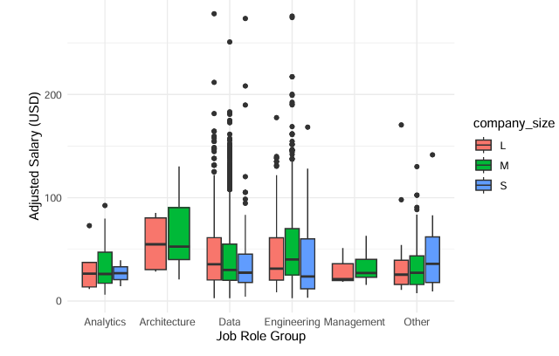
Adjusted Salary by Job Role Group and Company Size
Engineering: top median
Data: widest range
Architecture: high pay
Analytics/Management: lower tiers
Medium firms: most competitive
Small firms: narrow bands
Large firms: steady medians

Slide 7
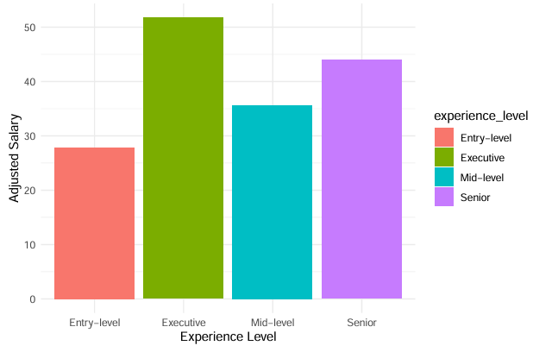
Avg Adjusted Salary by Experience Level
Executive: Top pay
Senior: high pay
Mid-level: moderate pay
Entry-level: lowest pay

Slide 8
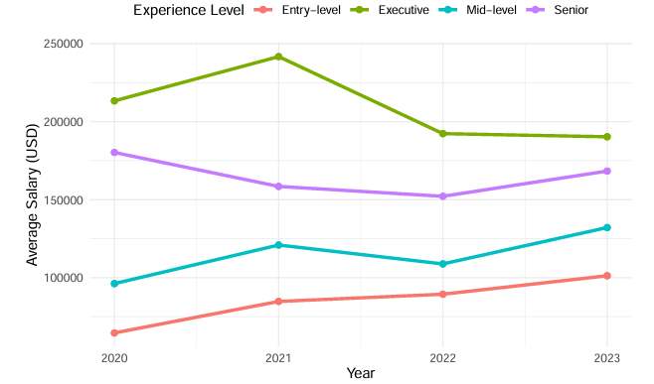
Average Salary Over Time by Experience Level (2020–23)
Entry: steady rise
companies raising base pay to attract new talent.
Mid: up ’21, dip ’22, up ’23
Covid boom → slowdown → market recovery.
Senior: dip to ’22, rebound ’23
budget cuts then catch-up promotions.
Exec: big jump in ’21, drop in ’22–’23
2021 bonuses then correction/post-pandemic realignments.
Overall: gains in ’23
inflation adjustments and renewed hiring.

Slide 9
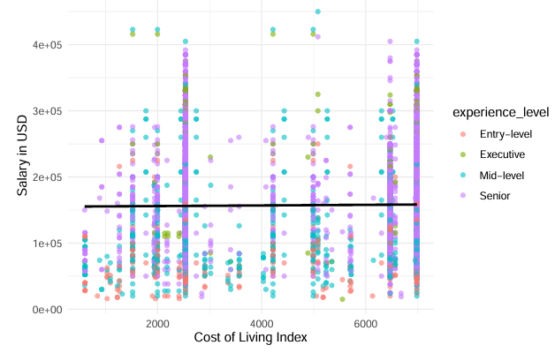
Salary vs Cost of Living
No COL Link
Remote work: same pay no matter where you live
Fixed pay bands: companies use one salary range for everyone
Job level & experience: these decide pay, not location
Global competition: firms match market rates worldwide

Slide 10
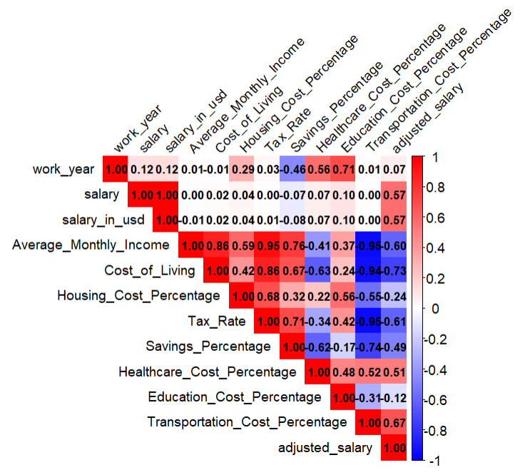
Correlation Matrix
1) Tax_Rate and Cost_of_Living have a strong positive correlation of 0.86- Regions with higher tax rates tend to also have a higher cost of living (r = 0.86), suggesting taxation is a major contributor to overall living expenses.
2) Adjusted salary is moderately negatively correlated with Average Monthly Income (r = –0.60) — suggesting high-income regions may also have high costs, reducing salary value.
3)Average_Monthly_Income and Savings_Percentage have a strong positive correlation of 0.76.As average monthly income increases, savings percentage also tends to increase (r = 0.76), indicating that people in high-income regions are able to save more despite living costs.

Slide 11
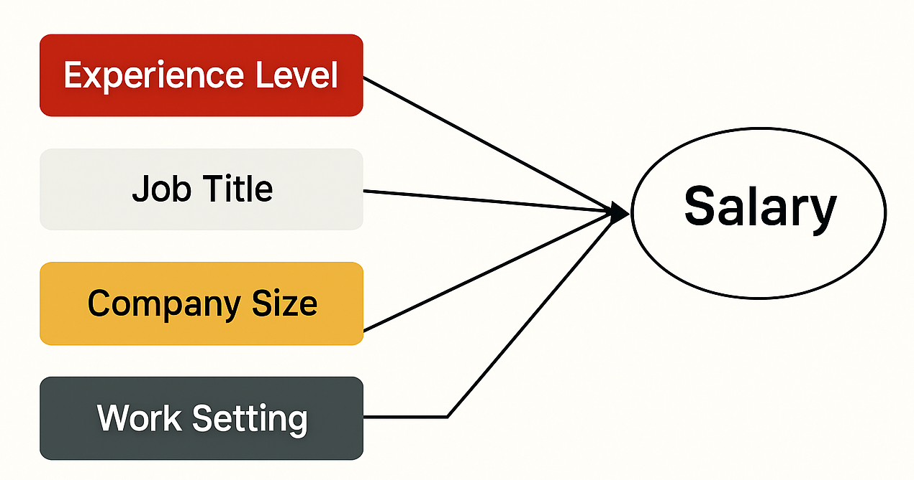
Regression Model for Salary Prediction
Applied the trained regression model to the test dataset
Calculated Root Mean Squared Error (RMSE) to measure prediction accuracy
RMSE indicates average deviation between predicted and actual salaries.
Then, we trained a multiple linear regression model using all key predictors (Experience Level, Job Title, Company Size, Work Setting), and applied it to the test set.
The overall RMSE of the full model was approximately 45,725, showing an improvement in accuracy when combining predictors rather than using them individually.

Slide 12
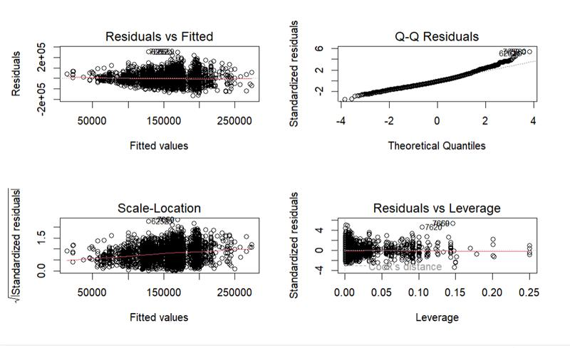
Model Diagnostics
Residuals vs Fitted
Checks if residuals are randomly distributed, implying a linear relationship between features and salary. Q-Q Plot (Normality Check)
Purpose: Assesses whether residuals follow a normal distribution—important for inference like confidence intervals and p-values

Slide 13

Interactive Salary Prediction Bot
A custom R Bot was developed to allow interactive salary predictions based on user input.
Prompts the user with options to answer the questions.
Ensures input is valid .
Internally builds a data frame with the input (factors aligned with training data).
Uses the trained regression model to predict salary.
final salary prediction is shown to the user, keeping internal details hidden for simplicity.
Helps simulate real-world use cases like salary estimators or HR tools.

Slide 14
Conclusion
Experience level remains the most significant factor—Executive and Senior roles earn the highest salaries
Cost of living does not have a strong direct correlation with salary—high living costs don’t always lead to higher pay
Adjusting for cost of living offers a fairer comparison across regions, revealing salary equity in unexpected places
Remote, hybrid, and in-person roles show similar salary patterns, supporting work flexibility
Regression diagnostics confirm that experience, role type, and company size better explain salary variation than geography alone

Slide 15

Thank you !

Slide 16


